Slide 1
Project Life cycle

Slide 2
The Context of IT Projects
IT projects can be very diverse in terms of size, complexity, products produced, application area, and resource requirements
IT project team members often have diverse backgrounds and skill sets
IT projects use diverse technologies that change rapidly. Even within one technology area, people must be highly specialized

Slide 3
Recent Trends Affecting IT Project Management
Globalization
Outsourcing: Outsourcing is when an organization acquires goods and/or sources from an outside source. Offshoring is sometimes used to describe outsourcing from another country
Virtual teams: A virtual team is a group of individuals who work across time and space using communication technologies
Plan-Driven management & Agile project management

Slide 4
Project Phases and the Project Life Cycle
A project life cycle is a collection of project phases that defines
  what work will be performed in each phase
  what deliverables will be produced and when
  who is involved in each phase, and
  how management will control and approve work produced in each phase
A deliverable is a product or service produced or provided as part of a project
The Software Development Process is often also called The Software Lifecycle or just simply The Software Process.

Slide 5
More on Project Phases
In early phases of a project life cycle
  resource needs are usually lowest
  the level of uncertainty (risk) is highest
  project stakeholders have the greatest opportunity to influence the project
In middle phases of a project life cycle
  the certainty of completing a project improves
  more resources are needed
The final phase of a project life cycle focuses on
  ensuring that project requirements were met
  the sponsor approves completion of the project

Slide 6
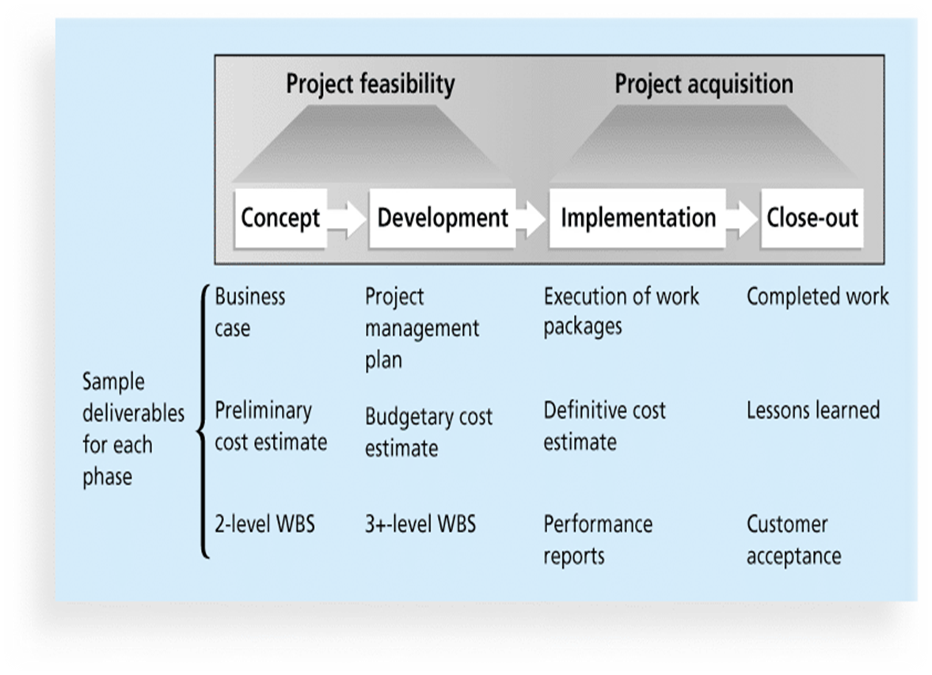
Figure 2-1. Phases of the Traditional Project Life Cycle

Slide 7
Systems Development projects
Systems development projects can follow
  Predictive life cycle: the scope of the project can be clearly articulated and the schedule and cost can be predicted
  Adaptive Software Development (ASD) life cycle: requirements cannot be clearly expressed, projects are mission driven and component based, using time-based cycles to meet target dates

Slide 8
Predictive Life Cycle Models
NETWORK DESIGN METHODOLOGY (PPDIOO Methodology (Cisco))
Waterfall model: has well-defined, linear stages of systems development and support
Spiral model: shows that software is developed using an iterative or spiral approach rather than a linear approach
Incremental model: provides for progressive development of operational software
Agile methods: Scrum, XP, RUP and Lean software development
Prototyping model: used for developing prototypes to clarify user requirements
Rapid Application Development (RAD) model: used to produce systems quickly without sacrificing quality

Slide 9
NETWORK DESIGN METHODOLOGY
PPDIOO Methodology (Cisco)

Slide 10
PPDIOO Methodology (Cisco)
Design is one component of network lifecycle
PPDIOO stages:
  Prepare
  Plan
  Design
  Implement
  Operate
  Optimise
Each phase builds on
its predecessor
P
P
O
R
D
O
I
10

Slide 11
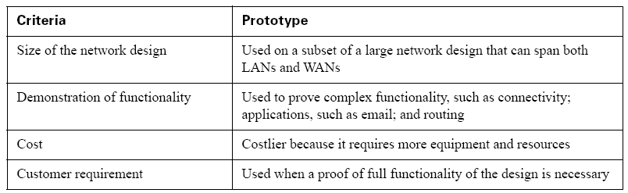
Network Prototype
Can provide “trial run” at minimal cost
11
25/11/2019

Slide 12
Step 1: Reviewing the Requirements
List major goals
Identify requirements for performance, scalability, security, capacity
Consider ROI, management, equipment reuse, cost of prototype
12
25/11/2019

Slide 13
Step 2: Determining the Extent of the Prototype
Creating the right-size prototype is critical
Cost and purpose can determine the size of the demonstration
Possibly roll out full prototype in one location
Can make use of simulations
13
25/11/2019

Slide 14
Step 3: Understanding Alternative Proposals
Probably several competing design alternatives
Plan prototype to highlight advantages of your solution
Gather information on other proposals, or make assumptions if this is not possible
14
25/11/2019

Slide 15
Step 4: Developing a Test Plan
Need prototype topology map
List and plan tests you will perform on prototype
Test plan should reflect goals
Demonstration may involve many people
Map out roles and responsibilities in a script
15
25/11/2019

Slide 16
Step 5. Purchasing and preparing equipment
Network simulation tools
Network hardware and software
End-system hardware and software
16
25/11/2019

Slide 17
Step 6. Practicing
Practice to coordinate demonstration
Practice with members of team
Don’t want surprises
17
25/11/2019

Slide 18
Step 7.Conduct final test and demonstration
Present prototype for usability testing
18
25/11/2019

Slide 19
Summary
PPDIOO process
  Prepare, Plan, design, implement, operate and optimise
Network documentation
  Management summary, proposed solution, installation and support, summary and appendices
Steps for prototyping
  Review, determine extent, alternatives, test plan, equipment, practice, demonstration
19
25/11/2019

Slide 20
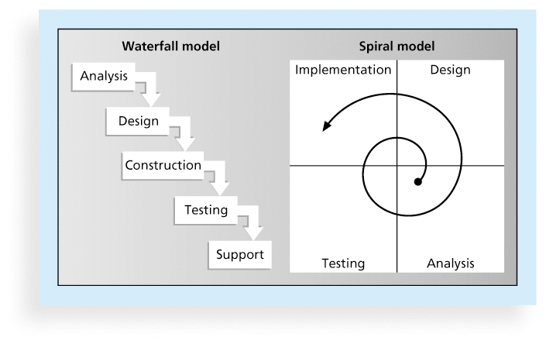
Figure 2-2. Waterfall and Spiral Life Cycle Models

Slide 21
Waterfall Approach
First life cycle used by software developers
Suggests a systematic sequential approach to software development
The Waterfall approach assumes all requirements are written down before producing them
Each definition is ‘signed off’ by the user before starting work
25/11/2019

Slide 22
Waterfall Approach: Advantages
Simple to understand
Clearly breaks up the process of software development giving a clear framework for management
Milestones/deliverables are easily identified
Each stage should produce documentation (useful for maintenance/quality assurance)
Cost estimations can be applied
25/11/2019

Slide 23
Waterfall Development Lifecycle: disadvantages
Late discovery of issues
Subjective and error-prone measure of progress
Late integration and testing
Precludes early deployment
Frequently results in major unplanned iterations

Slide 24
What Happens in Practice
Sequential activities:
Requirements Design Code Integration Test
100%
Integration
Begins
Late Design
Breakage
Development Progress
(% coded)
Original
Target Date
Project Schedule

Slide 25
Waterfall: Hard to Scale up
A waterfall approach can not properly handle the growing complexity associated with
  Increased duration
  Increased application size
  Larger and/or distributed team
  Increased technical complexity
  Novelty of technology
The root cause of the problem with the waterfall lifecycle is that it does not allow us to identify and mitigate risks early enough

Slide 26
Agile Software Development
Agile software development has become popular to describe new approaches that focus on close collaboration between programming teams and business experts.

Slide 27
Better Progress Profile
Sequential phases, but iterative activities
Prototypes Architecture Functional Product Releases Release
100%
Modern
Project Profile
Development Progress
(% Coded)
Waterfall
Project Profile
Project Schedule
Walker Royce, 1995
Notes:
One thing to note from this graph is that a waterfall project does not produce any code until well into the project whereas a modern iterative project provides code right from the start.

Slide 28
Agile by attack
Some Project managers (PMs) associate “agile” with “uncontrolled”/”undisciplined” etc
Prefer command & control project management
Why change? Existing process works”
“Customers won’t like it”
“Only works for big projects”
Quick to blame failure on process

Slide 29
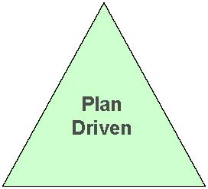
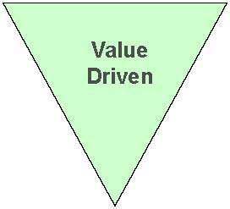
Plan driven vs. Agile
Traditional Method
(Plan-driven)
Agile method
(value-driven)
Fixed
Cost
Resources
Time
Resources
Time
Cost
Estimates
The plan creates cost/schedule estimates
Releases feature intent drive estimates
Notes:
Traditional method: based on budget to estimated resources (scopes) and project delivery time
Agile method:
based on features and delivery time for each feature to estimated the cost. So it can be on time and on features to delivery the project.
Because agile method tries to on time and on budget to delivery the project based on how many features customer wants. So it tides up with its cost and time
Agile: Estimated each feature how much time they need and what is cost. So it fixed the cost and delivery time. (it makes sure that the project will delivery on time and on budget but not full of functions.
Traditional: Estimated the scopes and cost how much time they need it. So it fixed the requirements. ( it might be end of project delivery late and/or over budget even fail to delivery the project totally. P.S. when they delivery the project late it might cost the customers loose it business opportunity. (eq. ebay’s website only breakdown for 24 hours, they loose (XXXXXXXXXX find how much they lost in a day??????????????????)
“Project success” Success is defined here as a project being completed on-time, on-budget and on-scope. Any factors which cause the project fail would be a risk factor, in other words any success factor contributing to project success would be a way to handle the risks.
Dealing with the triple constraints-Scope, budget and schedule- of project management almost requires trade-offs. For instance: producing a project on schedule and within the budget might result in a product that lacks the features and functions users thought they were paying for. Based on the Standish Group report, an IT consulting firm report $275 billion is spent on software development project each year in the U.S alone. More than 70% of these projects suffer total failure, cost over runs, schedule overruns or deliver few functions than promised.

Slide 30
The “Inverted Pyramid” principle
- as used by Newspapers around the world
priority
Time
Editors
scissors
Source from Clarke Ching
Cut according to space constraints (Time and Budget)
Notes:
Priority needs to take into about value and effort

Slide 31
Feature Usage
Source: Standish Group 2002
Notes:
Source from IBM: 10 codes per day and 50 codes per week.
Although project results have improved slightly over the last few years, the Standish group’s Chaos Report tells us that 72% OF PROJECTS fail or are challenged. The challenge means, project is completed and operational but over-budget, past deadline, and/or with fewer features and functions than originally specified. In this figure, you can see 45% of features implemented are never used, and 19% are rarely used. The most disturbing part is that practices known to drive more successful project outcomes are frequently not adopted.

Slide 32
80% and 20% theory
Wilfredo Pareto
16th century Italian economist
80% benefit from people can be obtained from 20% of features but we need a method to quantify the 20% of features that will give 80% of benefit.

Slide 33
Agile Project
Sponsors
Product owner/customer: for prioritising the work
Scrum master/Project manager: for assuring the scrum process is followed.
The whole team: developers-testers-domain experts
Management: for providing the right expertise to the team.
Notes:
Sponsor: provided direction to product owner/customers: they are able to access to iteration reviews to see growth value being delivered
Customer:
owns the product backlog
Decides on release dates and content
Prioritises backlogs e.g. content of next iteration
Can change features and priority every iteration
( how do they prioritises the feature? Not easy!!)
Project manager:
Ensures that process is followed
Helps people improve- servant leader
Promotes cooperation-removes barriers
Helps runs stand ups, planning and reviews
Ensures progress is radiating and plan is alive
Whole team:
Organises itself and the iteration work (backlog of tasks-story sign off)
Cross- functional team of less than 10 people
Presents working software to customer community at iteration (sprint) review.
Management responsibilities are to
1. provide strategic vision, business strategy and resources
2. remove impediments surfaced by scrum teams that the teams cannot remove themselves
3.ensure growth and career path of staff
4. Challenge the scrum teams to move beyond mediocrity

Slide 34
Visibility into the project activities
Team iteration
Sprint planning meeting
Daily scrum meetings
Sprint review meeting
Sprint backward-looking meeting
Notes:
Scrum daily meeting: (standing talk ofr 10 minutes)
What you did yesterday?
What problems you had?
What are you going to do today?

Slide 35
What is good quality software?
Key to developing good quality software is the process
  Methods and Tools are then complimentary to that
How can we measure good quality software
  Maintainable
  Reliable
  Efficient
  Offers an appropriate user interface

Slide 36
Agile Value
Individuals and interaction over process and tools
Customer collaboration over contract negotiation
Responding to change over following a plan
Simple but hard work!!
Notes:
--Individuals and interaction over process and tools:
Build projects around motivated individuals. Give them the environment and support they need, and trust them to get the job done.
---Working software over comprehensive documentation:
working software is the key measure of progress. Agile processes promote sustainable development. The sponsors, developers ,and users should be able to maintain a constant pace for the foreseeable future.
Continuous attention to technical excellence and good design enhances agility
----Customer collaboration over contract negotiation:
business people and developers must work together daily throughout the project
Our highest priority is to satisfy the customer through early and continuous delivery of valuable software
---Responding to change over following a plan:
welcome changing requirements, even late in development. Agile processes harness change for the customer’s competitive advantage
We need best architectures, requirements and designs emerge from self-organising teams. Also base on the regular intervals, the team reflects on how to become more effective then tunes and adjusts its behaviour accordingly.

Slide 37
Agile method
The successful factors are
Prefer a project started with a small group.
Co-location
Customer onsite
Business application
Rapid application development (RAD) programming environment
Short lifecycle
Common culture
Notes:
Some researchers and project mangers think the SDLC is lack of agility. As this method (so called heavy method) is based on scope-budget-schedule model which has caused the software engineering community to seek better methods of reducing variance.
The agile software process has become a hot topic among consultants, practitioners and researchers through concepts like Extreme Programming and SCRUM.
Software development often involves new technology, challenging or unknown requirements and tight schedules- making particularly having a tendency to several types of risk.
Many of the practical challenges in software engineering are not limited to technological issues. Managerial issues, communications, personnel relationships and competence/know-how management often have a large impact on a software project’s success.
This study explores and studies these issues of software management from three specific perspectives:
How commitments are made and managed
How the risks are managed
The summery of the successful factors are as follows:
Prefer a project stated with a small group. It is possible to maintain high-bandwidth, one-to-one communication when a project has around 10 to 15 people. But this starts to become difficult when the team size exceeds twenty people. With smaller teams, no specialisation of roles (analyst, designer, coder, tester), with resign of work of art, is necessary.
Co-location. Again, this allows high-bandwidth communication and synchronous communication between people.
Customer onsite. The project as a whole needs ready access to a competent and empowered customer representative, who can make decisions about the system. When the project team has direct access to the customer, it becomes easier for course corrections to be made periodically, thus picture a better product at the end of the project.
Business application. Agile development works better for business software projects in which interactive types of applications are being built. It works less well for other kinds of projects: for example, an embedded real-time system.
Rapid application development (RAD) programming environment. Agility requires a rapid application development environment that allows fast change from construction of code to testing and collective code ownership; ideally, development teams do daily development and monthly delivery based on the project schedule.
Short lifecycle. Projects should not exceed a few months and ideally have a rapid internal loop.
Common culture. Company’s culture in vocabulary and an understanding process are shared, and individual developer practices rapidly support with each other.
Communication is direct, including communication with the most interested stakeholder and the customer.

Slide 38
Scrum
Scrum (Schwaber and Sutherland, 1995; 2002)
A common focus on
Working software
Team interactions
Customer collaboration
Adapting to change
Notes:
Say what you do
Do what you say
Show you did it
--Individuals and interaction over process and tools:
Build projects around motivated individuals. Give them the environment and support they need, and trust them to get the job done.
---Working software over comprehensive documentation:
working software is the key measure of progress. Agile processes promote sustainable development. The sponsors, developers ,and users should be able to maintain a constant pace for the foreseeable future.
Continuous attention to technical excellence and good design enhances agility
----Customer collaboration over contract negotiation:
business people and developers must work together daily throughout the project
Our highest priority is to satisfy the customer through early and continuous delivery of valuable software
---Responding to change over following a plan:
welcome changing requirements, even late in development. Agile processes harness change for the customer’s competitive advantage
We need best architectures, requirements and designs emerge from self-organising teams. Also base on the regular intervals, the team reflects on how to become more effective then tunes and adjusts its behaviour accordingly.

Slide 39

Rugby

Slide 40
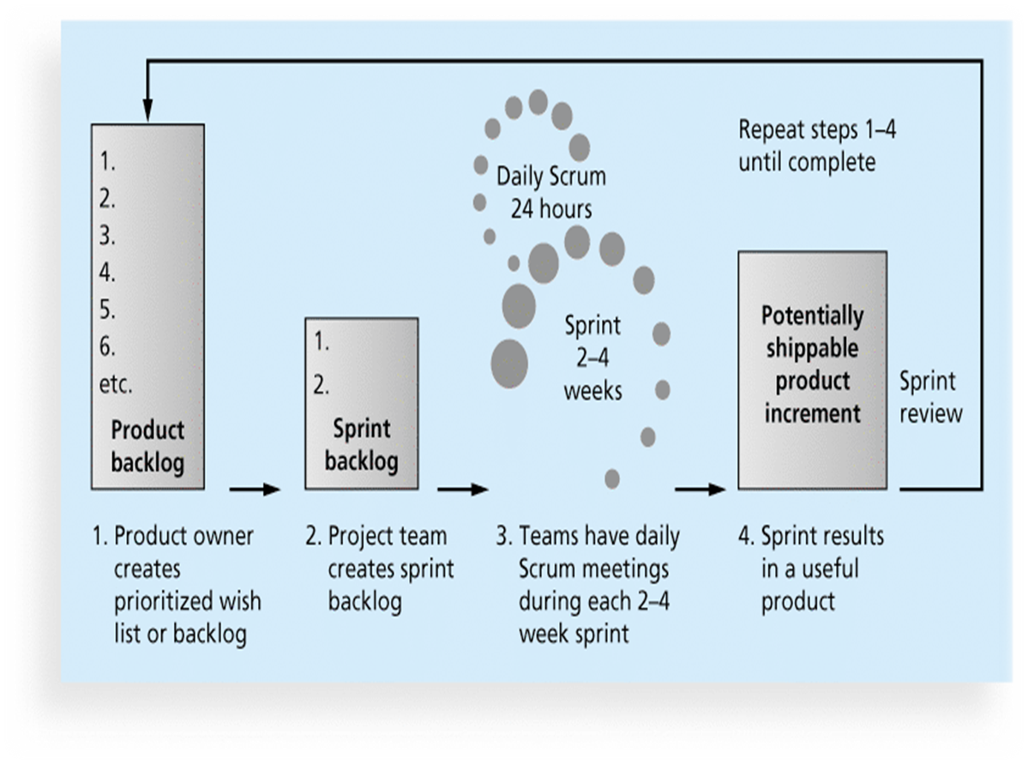
Figure 2-3. Scrum Framework

Slide 41
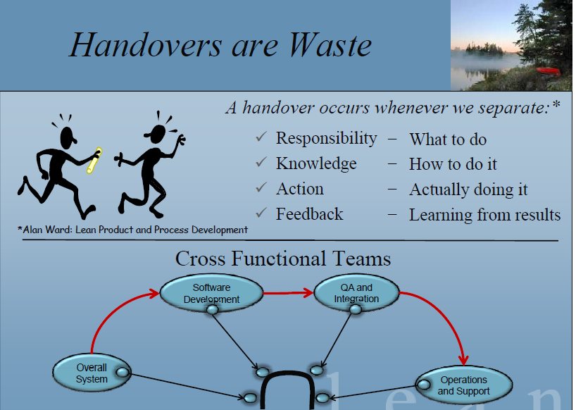
SCRUM Introduction Cont.
41
25/11/2019

Slide 42
SCRUM Introduction Cont.
Web application
Multi-terabyte database applications
Application development environment
Call centre systems
Biotech
Financial payment applications
Enterprise workflow systems etc.
Data source from Mountain Goat Software company
42
25/11/2019

Slide 43
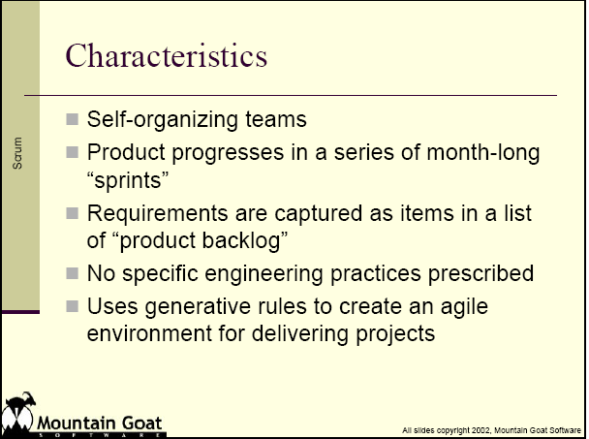
SCRUM Introduction Cont.
43
25/11/2019

Slide 44
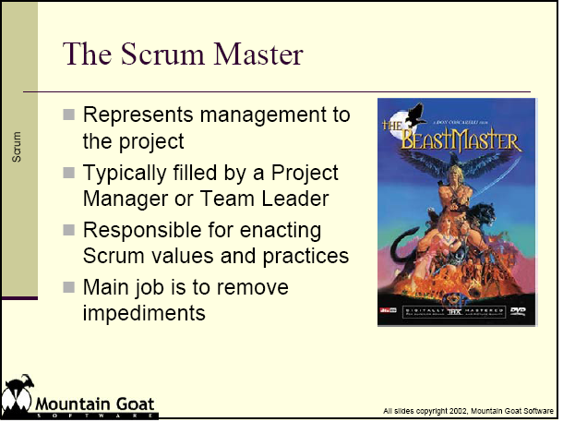
SCRUM Introduction Cont.
44
25/11/2019

Slide 45
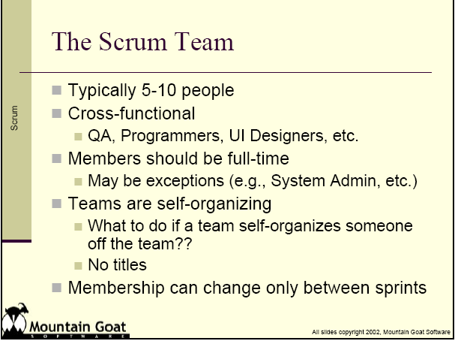
SCRUM Introduction Cont.
45
25/11/2019

Slide 46
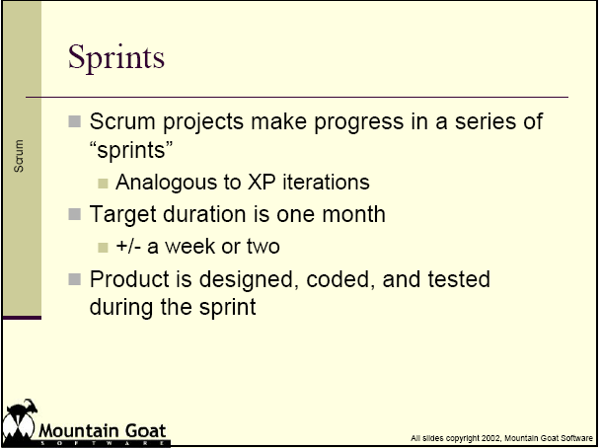
SCRUM Introduction Cont.
46
25/11/2019

Slide 47
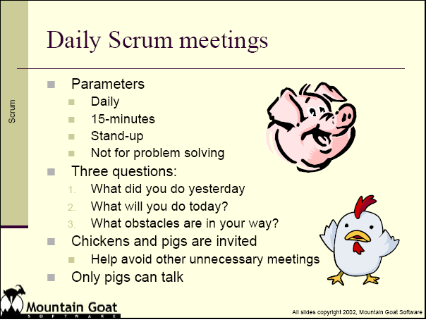
SCRUM Introduction Cont.
47
25/11/2019

Slide 48
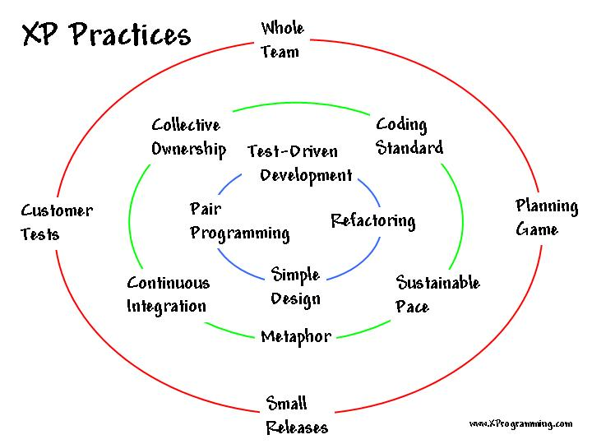
XP Practices and main “cycles” of XP
48
25/11/2019

Slide 49
Extreme Programming (XP)
5 Fundamental Values
  Communication
  Feedback
  Simplicity
  Courage
  Quality
49
25/11/2019
Notes:
5 Fundamental Values
Communication
Feedback
Simplicity
Courage
Quality

Slide 50
XP2: The 12 Core Practices
From Extreme Programming Explained Second Edition, Kent Beck, 2006
XP2 Primary Practice
Sit together
Whole team
Informative workspace
Energised work
Pair programming
Stories
Weekly cycle
Quarterly cycle
Sustained/New/XP1 Name
New
New
New
40-hour Week
Sustained
Planning Game
Planning Game
Small releases
50
25/11/2019

Slide 51
XP2: The 12 Core Practices
From Extreme Programming Explained Second Edition, Kent Beck, 2006
XP2 Primary Practice
Ten minute build
Continuous integration
Test-first Programming
Incremental Design
Sustained/New/XP1 Name
New
Sustained
Testing
Simple Design
Refactoring
51
Edwin Gray e-mail: e.gray@gcu.ac.uk
Department of Computer, Communications and Interactive Systems
25/11/2019

Slide 52
XP2: The 12 Core Practices
From Extreme Programming Explained Second Edition, Kent Beck, 2006
XP1 Practice
Metaphor
Collective code ownership
On-site customer
Coding standard
Disposition
Removed
Corollary: Shared code
Corollary: Real customer involvement
Removed
52
Edwin Gray e-mail: e.gray@gcu.ac.uk
Department of Computer, Communications and Interactive Systems
25/11/2019

Slide 53
Rational Unified Process (RUP) and UML
Unified Modelling Language provides visual language for OO projects.
Rational Unified Process provides process model.
Approach ‘open’ (non-proprietary) but Rational Corporation offers Rational Unified Process.
Four phases to process:
  Inception
  Elaboration
  Construction
  Transition.
25/11/2019
53

Slide 54
Iterative Development
Iteration 1
Iteration 2
Iteration 3
An iteration is a distinct sequence of activities with an established plan and evaluation criteria, resulting in an executable release.
Earliest iterations address greatest risks
Each iteration produces an executable release
Each iteration includes integration and test
Notes:
Iterative development divides the total work undertaken on the project into iterations.
Each iteration is like a mini waterfall.
Each iteration tackles a fixed portion of the system under development.
Each iteration delivers usable software that can be delivered to stakeholders.
Project planning ensures that the riskiest work is undertaken in the earlier iterations, this ensures that issues are discovered early.

Slide 55
RUP 9 principles and 4 phases
25/11/2019

Slide 56
Iterative Development Phases
Major Milestones
Inception
Elaboration
Construction
Transition
Time
Inception: Agreement on overall scope
  Vision, high-level requirements, business case
  Not detailed requirements
Elaboration: Agreement on design approach
  Baseline architecture, most requirements detailed
  Not detailed design
Construction: Apply approach
  Working product, system test complete
Transition: Validate solution
  Stakeholder acceptance

Slide 57
Use-Case Driven Development
A use case describes complete and meaningful services that your system offers to users and other systems
Use cases drive the work through each iteration
  Planning of iterations
  Creation and validation of the architecture
  Definition of test cases and procedures
  Design of user interfaces and creation of user documentation
Requirements
Use-Case Model
realized by
Analysis & Design
Analysis & Design Model
implemented by
Implementation
Implementation Model
verified by
Test
Test Model

Slide 58
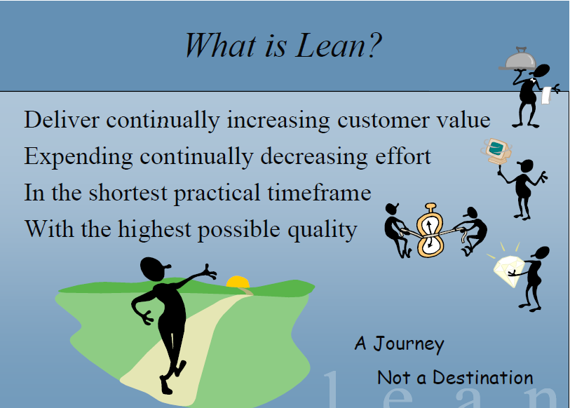
Lean Development Cont.
25/11/2019

Slide 59
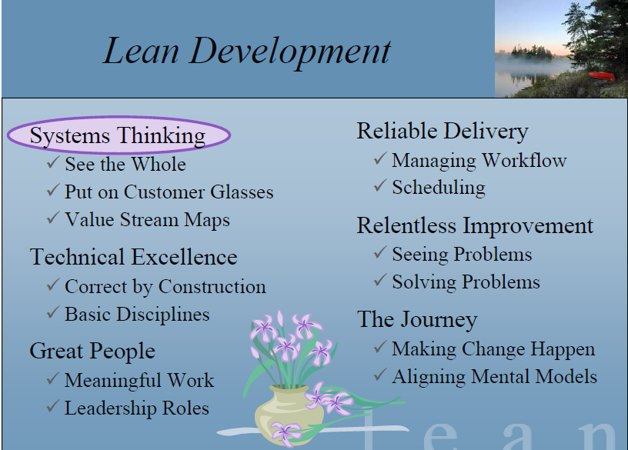
Lean Development Cont.
25/11/2019

Slide 60

Lean development
25/11/2019

Slide 61
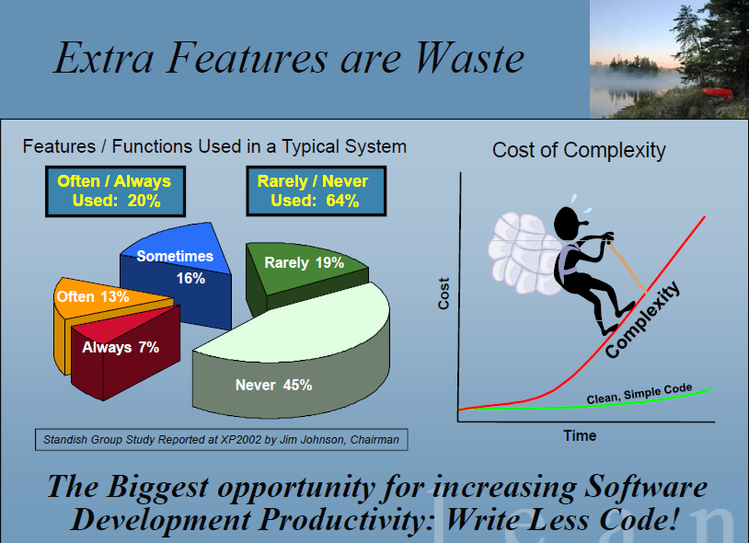
Lean development
25/11/2019

Slide 62
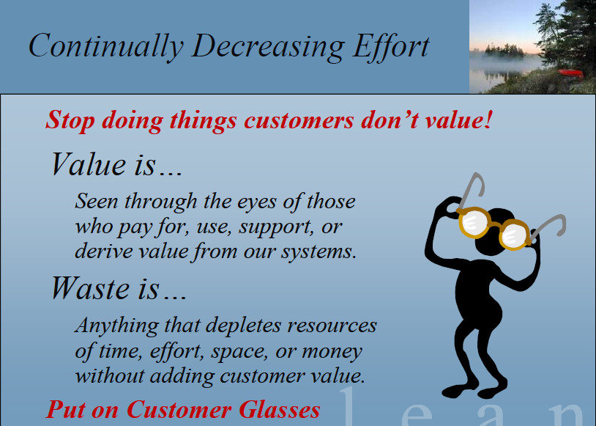
Lean development
25/11/2019

Slide 63
Evolutionary Models
  Prototyping
  Spiral Model
  Rapid Application Development (RAD) Model
  Incremental Model
  (and now) Agile Programming
25/11/2019
Notes:
Classical Life Cycle model fails if requirements cannot be specified fully and clearly early on.
Can a system be developed without having to specify all requirements early on? - Answer: It depends/maybe! Only if the nature of the application suits this type of model:

Slide 64
The Prototyping Model
Project Initiation
Interact/listen
to customer
Build/revise
Mock-up
Customer
‘test drives’
Mock up
Systems
25/11/2019
Notes:
Not really a complete life cycle model - a technique for establishing user requirements
It is not, however, the “lazy” programmer’s technique. It involves:
A detailed requirements gathering exercise,
the development of prototype
a rigorous evaluation of the prototype with the customer (then Iteration)
Key points to remember for Prototyping to be a success:
Do not proceed to the real design or coding stage until full requirements analysis.
If the customer cannot devote sufficient time to the prototyping exercise it is pointless

Slide 65
The Prototyping Model:
Sometimes viewed as a life cycle model
More accurate to describe it as a technique for establishing user requirements
Often used with other models (RAD, Spiral Model, Waterfall)
25/11/2019

Slide 66
The Prototyping Model: continued
Will depend on whether the final software to be developed lends itself to prototyping
Depends on the availability of appropriate prototyping tools to assist the process
Begins with requirements gathering
Quick design occurs
Prototype is developed
Prototype is evaluated
Process is repeated
25/11/2019
Notes:
!
Customer might think they are seeing a “working” system. It is not and must be “thrown away”. They must appreciate that.
Developer must not make implementation compromises based on the prototype.
What is a suitable type of application for Prototyping?

Slide 67
Kanban
Technique that can be used in conjunction with scrum
Developed in Japan by Toyota Motor Corporation
Uses visual cues to guide workflow
Kanban cards show new work, work in progress, and work completed

Slide 68
If Agile methods have so many positive feedback from industry why IT projects still go wrong?
Interview with IT managers
Agile teams focus on features too much and forget the non-functional requirements are very important such as reliability, interface, also like staff training, decision making, allow customers change their requirements (each requirement most likely is fix price) but need to let them know that the schedule and budget will increase also may lead their business lose their market due to late delivery the project.
It would work on the large project but need every strong management skills.
It is like so many mini-waterfall iteration. Most Agile project will combine two or more agile methods to make a project work. It depends on manager’s experience most.

Slide 69
Key Terms Cont.
adaptive software development (ASD) A software development approach used when requirements cannot be clearly expressed early in the life cycle
agile Quick and coordinated in movement; a method based on iterative and incremental development, in which requirements and solutions evolve through collaboration
agile software development A method for software development that uses new approaches, focusing on close collaboration between programming teams and business experts
champion A senior manager who acts as a key proponent for a project

Slide 70
Key Terms Cont.
deliverable A product or service, such as a technical report, a training session, a piece of hardware, or a segment of software code, produced or provided as part of a project
executive steering committee A group of senior executives from various parts of the organization who regularly review important corporate projects and issues
functional organizational structure An organizational structure that groups people by functional areas such as IT, manufacturing, engineering, and human resources
human resources (HR) frame A frame that focuses on producing harmony between the needs of the organization and the needs of people

Slide 71
Key Terms Cont.
IT governance The authority and control for key IT activities in organizations, including IT infrastructure, IT use, and project management
kill point A management review that should occur after each project phase to determine if projects should be continued, redirected, or terminated; also called a phase exit
matrix organizational structure An organizational structure in which employees are assigned both to functional and project managers
offshoring Outsourcing from another country

Slide 72
Key Terms Cont.
organizational culture A set of shared assumptions, values, and behaviors that characterize the functioning of an organization
outsourcing An organization’s acquisition of goods and services from an outside source
phase exit A management review that should occur after each project phase to determine if projects should be continued, redirected, or terminated; also called a kill point
political frame A frame that addresses organizational and personal politics

Slide 73
Key Terms Cont.
politics Competition between groups or individuals for power and leadership
predictive life cycle A software development approach used when the scope of the project can be articulated clearly and the schedule and cost can be predicted accurately
project acquisition The last two phases in a project (implementation and close-out) that focus on delivering the actual work
project feasibility The first two phases in a project (concept and development) that focus on planning

Slide 74
Key Terms Cont.
project life cycle A collection of project phases, such as concept, development, implementation, and close-out
project organizational structure An organizational structure that groups people by major projects
Scrum The leading agile development methodology for completing projects with a complex, innovative scope of work
structural frame A frame that deals with how the organization is structured (usually depicted in an organizational chart) and focuses on different groups’ roles and responsibilities to meet the goals and policies set by top management

Slide 75
Key Terms Cont.
symbolic frame A frame that focuses on the symbols, meanings, and culture of an organization
systems Sets of interacting components working within an environment to fulfill some purpose
systems analysis A problem-solving approach that requires defining the scope of the system to be studied, and then dividing it into component parts for identifying and evaluating its problems, opportunities, constraints, and needs
systems approach A holistic and analytical approach to solving complex problems that includes using a systems philosophy, systems analysis, and systems management

Slide 76
Key Terms
systems development life cycle (SDLC) A framework for describing the phases involved in developing and maintaining information systems
systems management Addressing the business, technological, and organizational issues associated with creating, maintaining, and modifying a system
systems philosophy An overall model for thinking about things as systems
systems thinking A holistic view of an organization to effectively handle complex situations
virtual team A group of people who work together despite time and space boundaries using communication technologies

Slide 77
Useful videos
Agile VS waterfall
https://www.youtube.com/watch?v=jL1VOF5JgPQ
Discover whether your project is a candidate for Agile SAP implementation. Agile SAP provides the IT organization with the ability to be flexible and to respond to a changing business environment unlike traditional "Waterfall" approaches. data source from :Genesis Consulting, accessed date:03/10/2016

